Slide 1
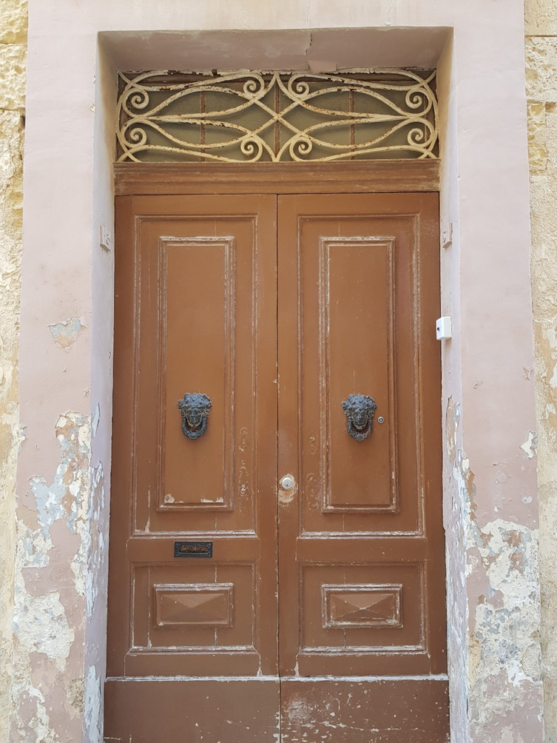
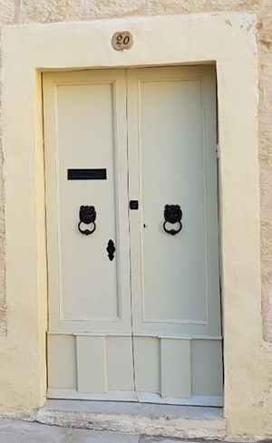
Mysterious doors
WORKSHOP
BY IVANA BURIĆ KURTOVIĆ AND EVA BOGDANOVIĆ
11TH ELT MALTA CONFERENCE 2022

Slide 2
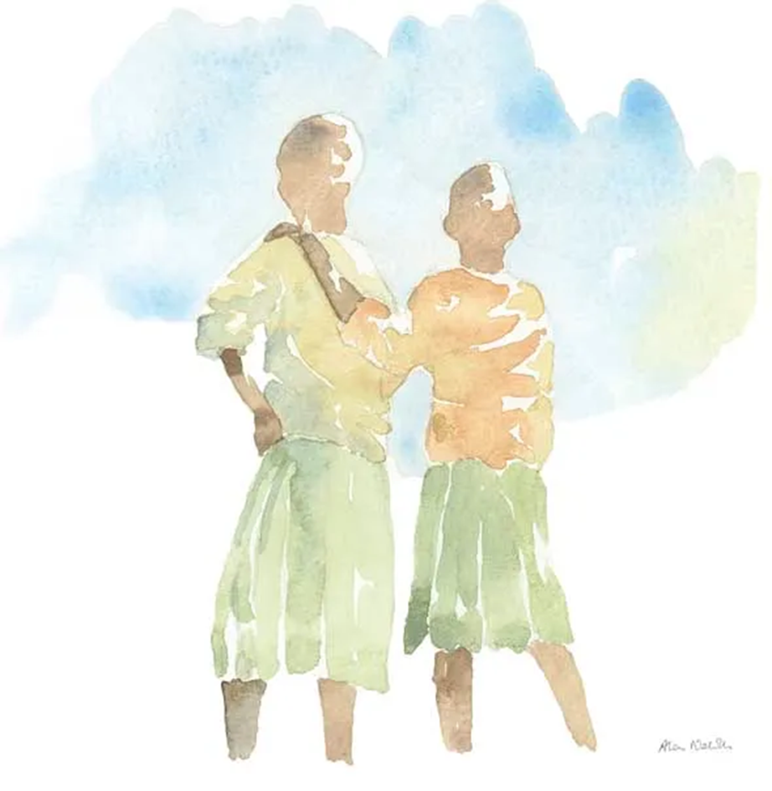
TWO SCHOLARS

Slide 3
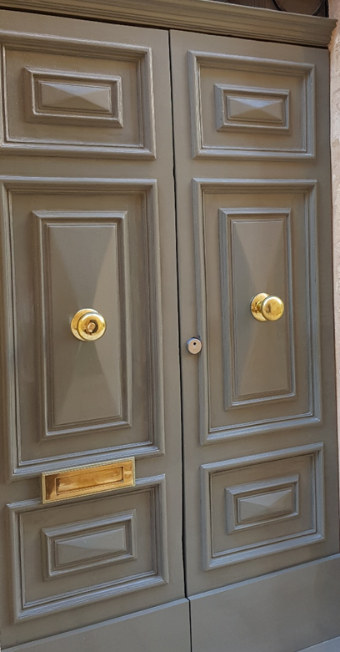
BEAUTIFUL GREY DOOR

Slide 4
BEE
SEA
TRAFFIC
ANGRY
SWEET
23 COUNTRIES
MANHATTAN
…THE ROAD
BEAR
ATLANTIC OCEAN
WATER
MIX
STICKY
EUROPE, AFRICA, ASIA
GOZO
CRUCIFIX
HONEY
THE MEDITERRANEAN
ISLAND
CROSS
M A L T A

Slide 5
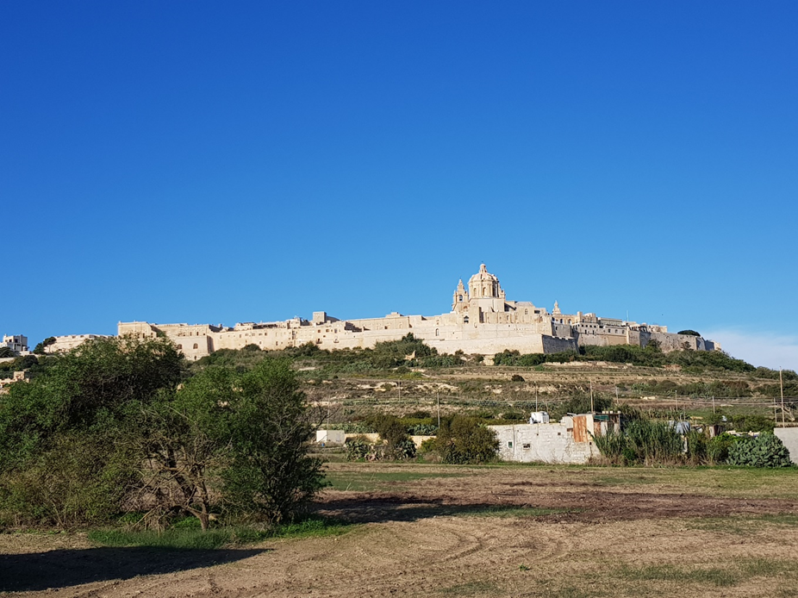
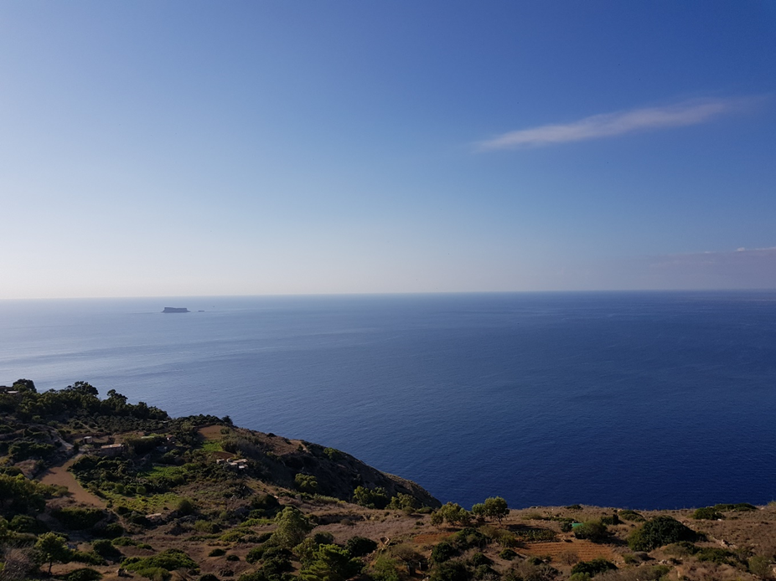
MALTA

Slide 6
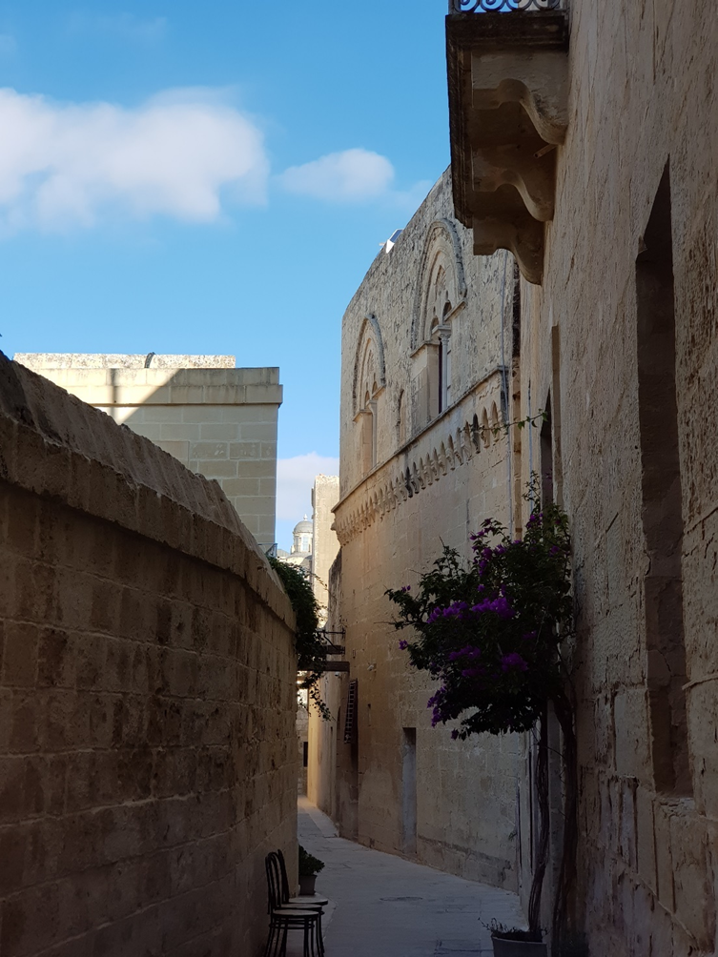
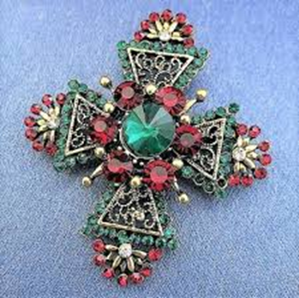
MALTESE CROSS

Slide 7
A. Take the cross to the Heritage Museum where it probably belongs
B. LEAVE IT ON THE FLOOR AND DO NOTHING
C. TAKE THE CROSS, SELL IT AND GIVE THE MONEY TO CHARITY
D. YOUR CHOICE…
DEBATE OPTIONS

Slide 8
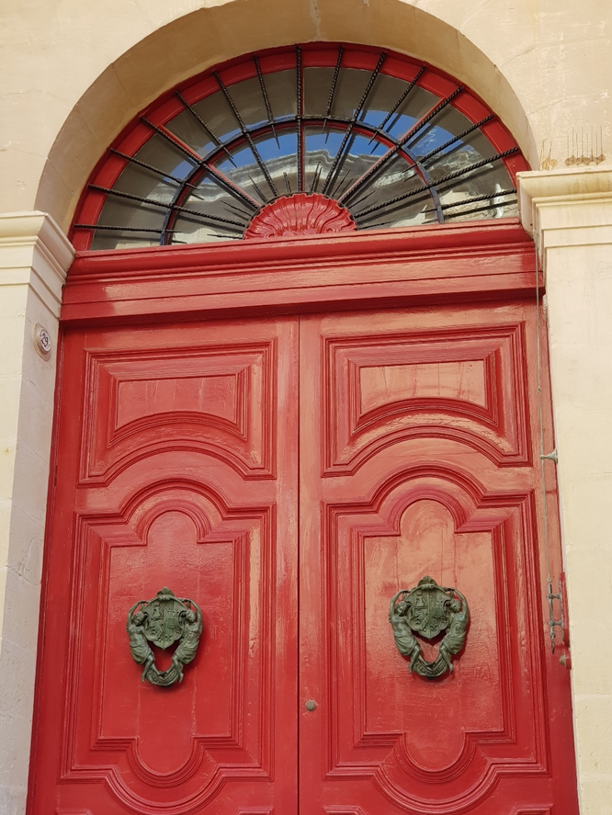
BEAUTIFUL RED DOOR

Slide 9
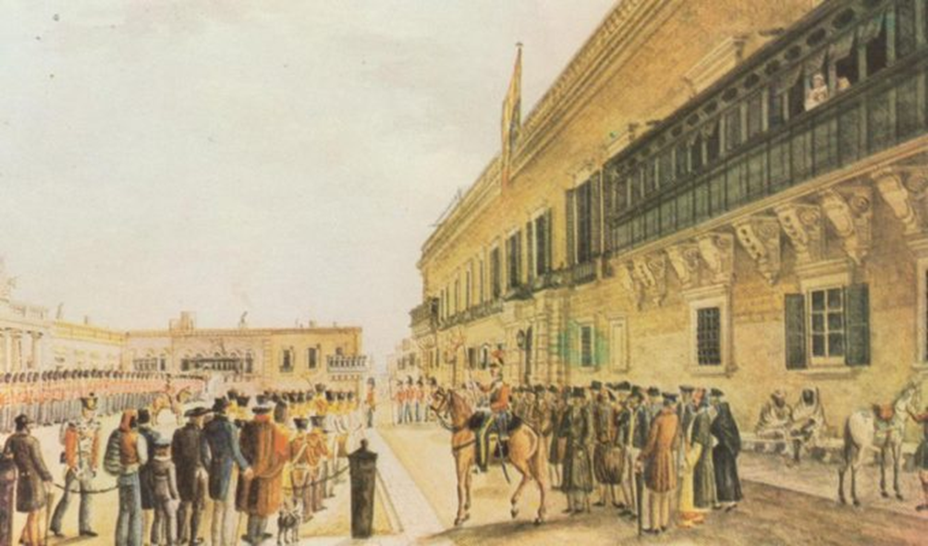
Photo: Palace Square 1820 by Charles Frederick Brocktorff
A HISTORICAL PERIOD

Slide 10
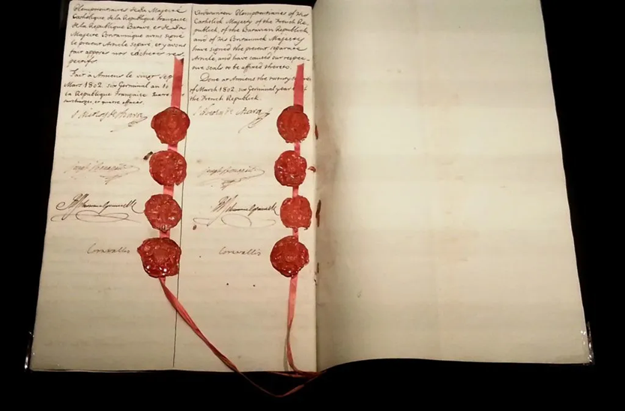
Photo: The Treaty of Amiens doc. The Treaty of Amiens, signed and sealed – Dorieo, Wikimedia Commons (License CC-BY-SA 4.0)
AN OLD DOCUMENT

Slide 11
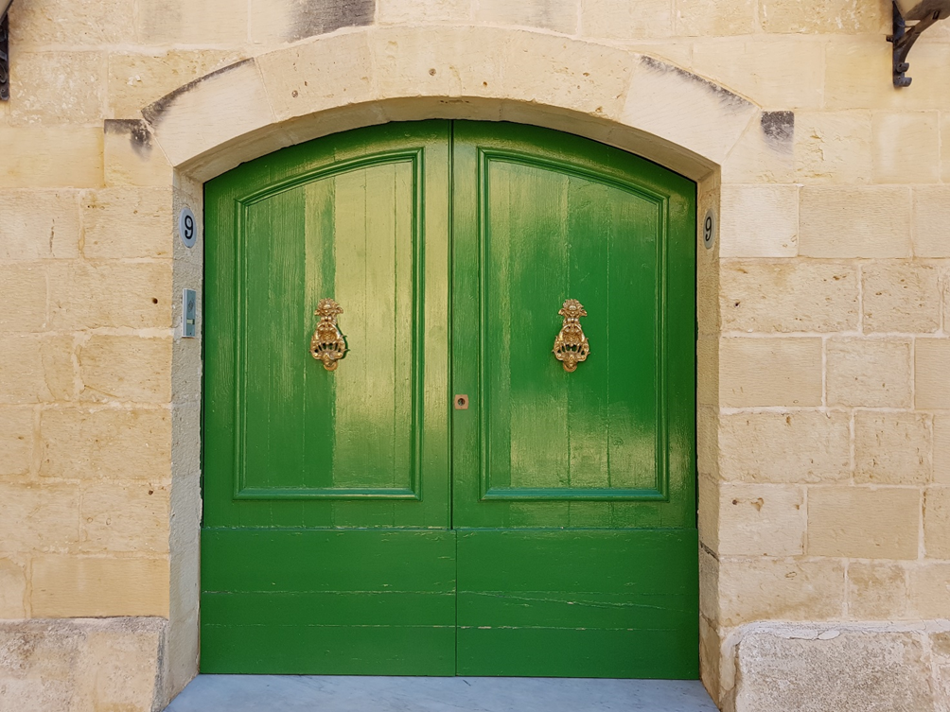
GREEN DOOR

Slide 12
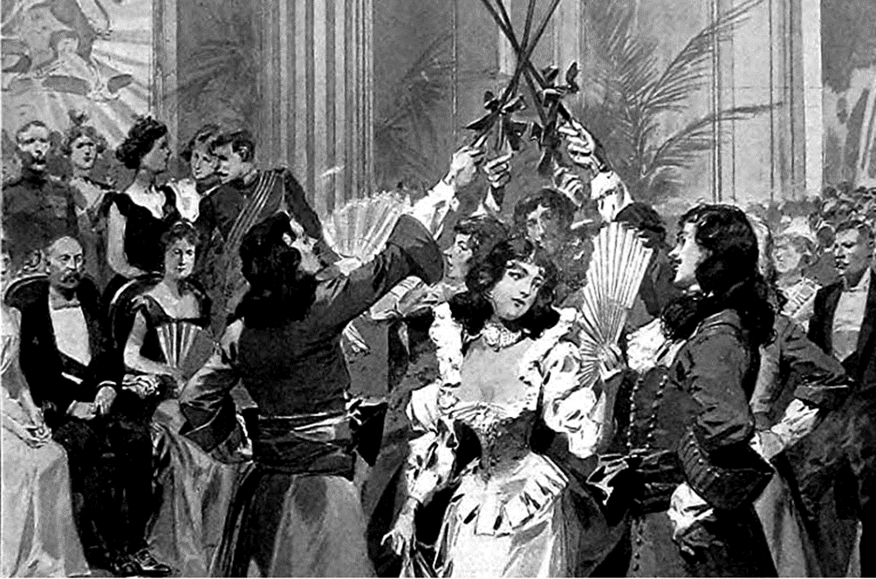
The Carnival Ball at the Palace, Malta, the Minuet by Frederic De Haenen, 1902 (detail) The Carnival Ball at the Palace, Malta, the Minuet. Illustration for The Graphic, 8 March 1902.
A ROOM WITH PEOPLE

Slide 13
Conversation taking place at the Carnival Ball, Valetta, 1902:
Lady 1:
“As I was getting here, driving on the omnibus, a young lady was sitting next to me. At first I didn’t recognize her, as she was wearing a ghonnella. I mean, it took up so much space, it was really impractical and made it almost impossible to sit next to her, not to mention that it covered her entire face. Tell me, who doesn’t want others to see their face these days so they hide behind ghonnella?
Lady 2:
“Yes, I agree. Oh, totally unrelated to that, I hope they won’t serve Kinnie with pineapple and ice-cream today. I strongly dislike the combination, as it disagrees with my indigestion.”
Lady 3:
“Shhh, look who’s at the brown door! It must be Lord Byron, I heard he’s leaving Malta soon and wants to read his latest poem Farewell to Malta to us tonight. Isn’t that exciting, I heard he’s quite a charmer on top of being a great poet.
A CONVERSATION

Slide 14
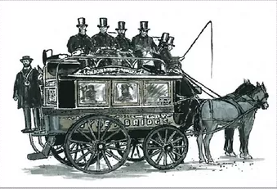
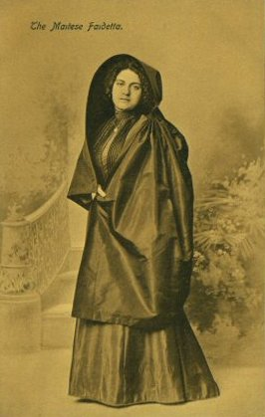
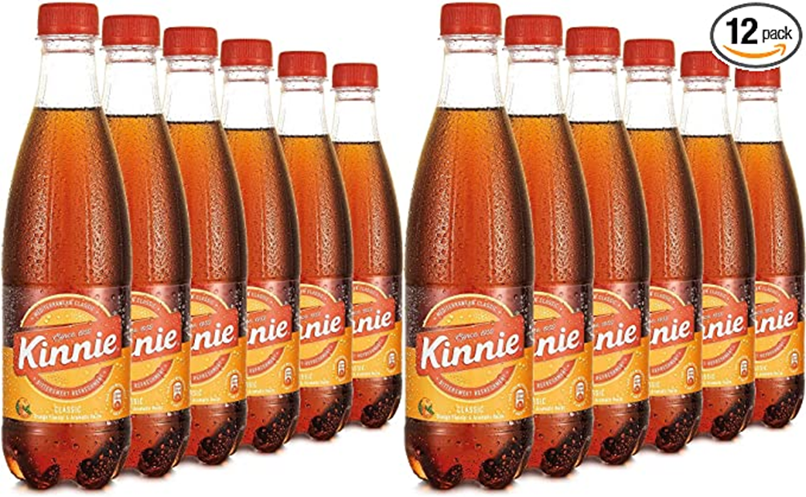
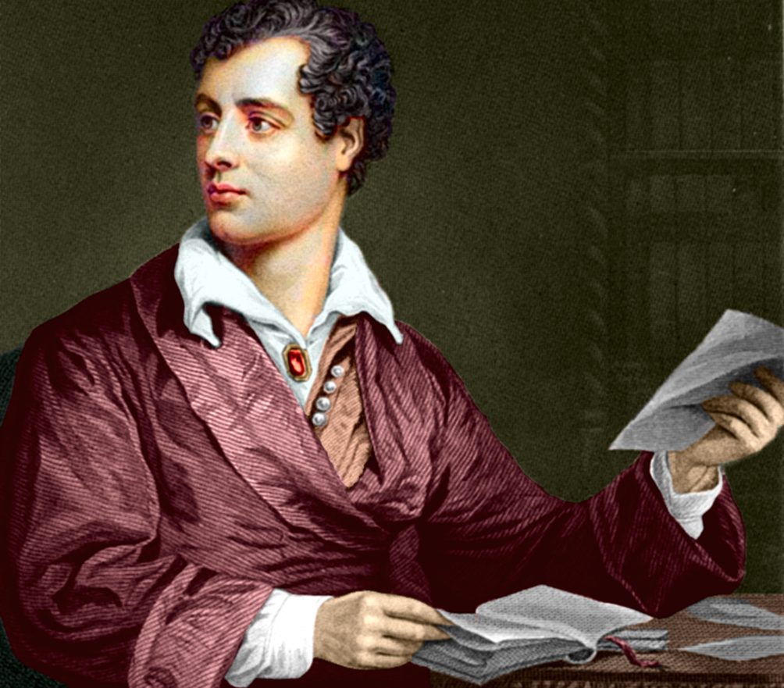
1 – OMNIBUS (HORSE-DRAWN OR NOT)
1856 the first Omnibus brought to Malta from England
2 – T H E G Ħ O N N E L L A,
sometimes referred to as a Faldetta, was a form of women's head dress and shawl, or hooded cloak, unique to the Mediterranean islands of Malta and Gozo. The għonnella covered the head, and framed but did not cover the face.
3 - FOOD AND DRINKS TIMELINE
4 – LORD BYRON
on Malta: He stopped here twice, the first time in 1809, during his Grand Tour of the Mediterranean littoral, and then on his return journey from the same adventure in 1811, while on his way back to England.
5 – KEY:
1 – OMNIBUS EXISTED
2 – GHONNELLA DIDN’T COVER THE FACE
3 – KINNIE DIDN’T EXIST
4 – BYRON WASN’T ALIVE
5 – FAREWELL TO MALTA WRITTEN IN 1811
ILLOGICAL STATEMENTS

Slide 15
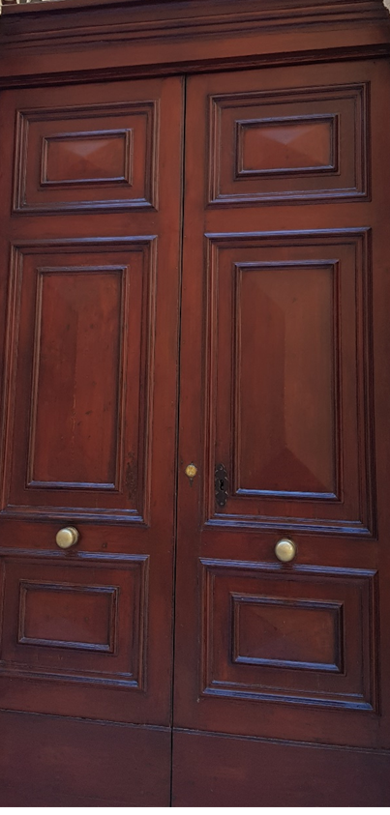
BROWN DOOR

Slide 16


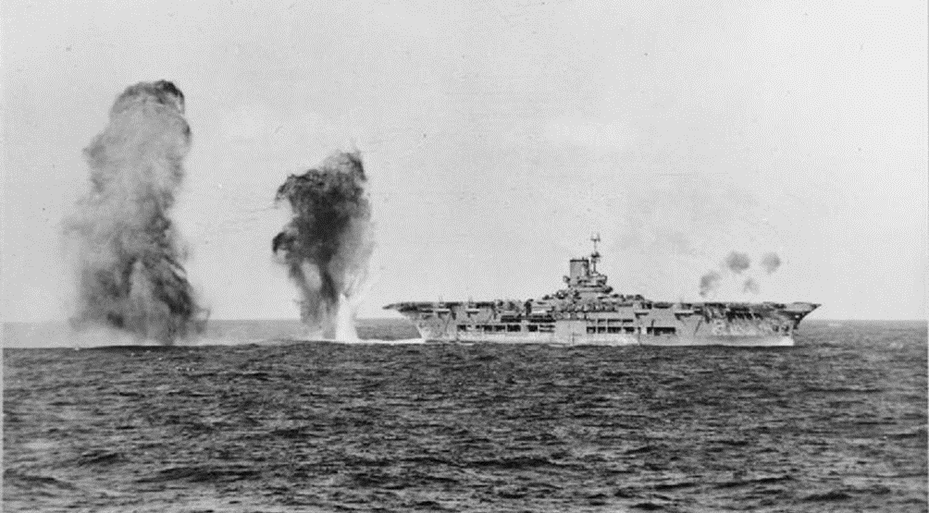
Photo: Malta Convoys, WW2, April 1941
BATTLES

Slide 17
1 What is a battle? Is it similar to a game?
2 Why do people engage in battles? Is it the start of conflict, or is it to end a conflict, or is it something completely different?
3 How do people know and recognize the winner and the loser, and is there always one? What are the consequences of being one?
4 Is the option of not participating in a battle a possibility? What are the consequences of taking that option?
5 What do you think your planet will gain from having battles in the future? How will battles improve the quality of life on Planet Earth?
BATTLE WITH QUESTIONS

Slide 18
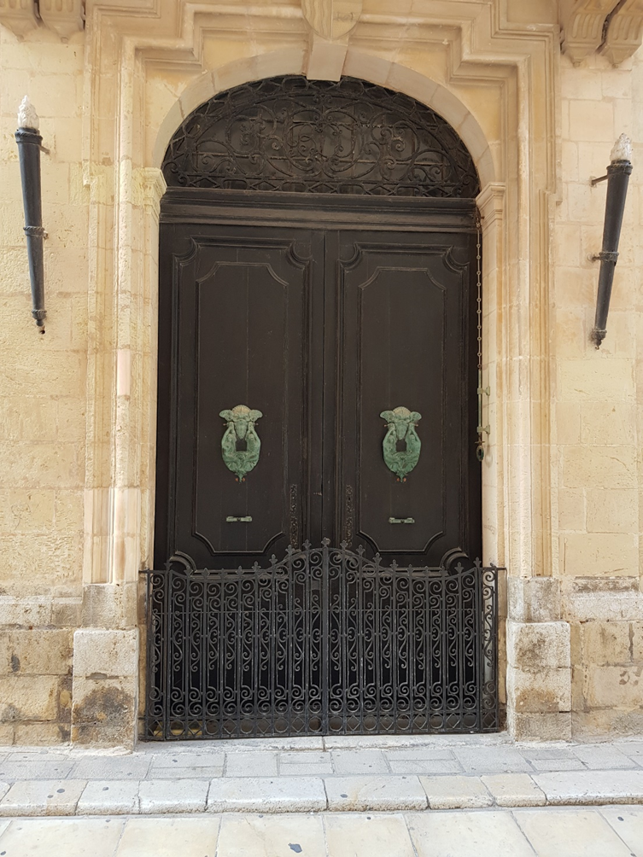
BLACK DOOR

Slide 19

Xgħajra is a small village and very few people live there all year round. Most people only come for six months of the year to make the most of the peaceful seashore. In winter the storms and gale force winds are extraordinary: the wind can sound like an angry wild dog on the prowl outside your window, and the waves rise as high as buildings until they finally smash and disintegrate against the sharp rocks. This is why most people decide to return to their homes in Ħaż-Żabbar for the colder months.
KISSIRTU KULLIMKIEN
(YOU’VE DESTROYED EVERYTHING)
A BOOK EXTRACT:

Slide 20
FACT / OPINION
1 Xghajra is a very boring and solitary place.
2 The waves in winter can be dangerous.
3 The writer of this paragraph wants to promote Xghajra.
4 Most people leave Xghajra in winter months because of the weather.
5 The writer is impressed by the winter winds and storms.
Xgħajra is a small village and very few people live there all year round. Most people only come for six months of the year to make the most of the peaceful seashore. In winter the storms and gale force winds are extraordinary: the wind can sound like an angry wild dog on the prowl outside your window, and the waves rise as high as buildings until they finally smash and disintegrate against the sharp rocks. This is why most people decide to return to their homes in Ħaż-Żabbar for the colder months.

Slide 21
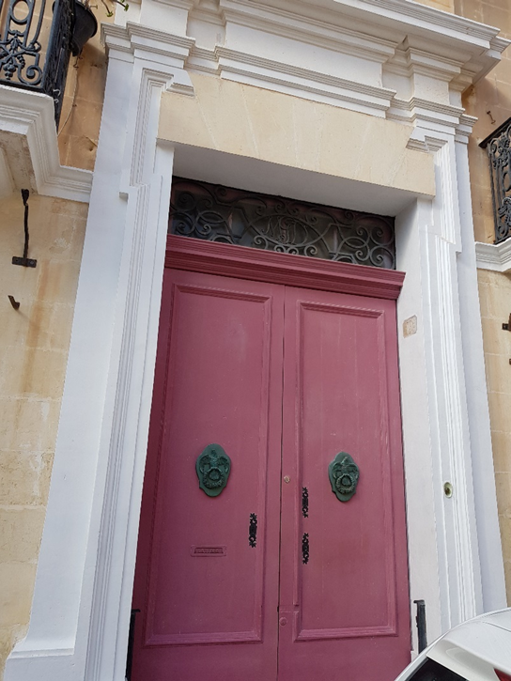
PINK DOOR

Slide 22
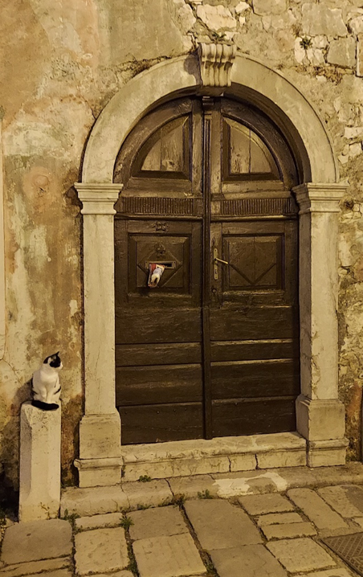
BROWN DOOR

Slide 23
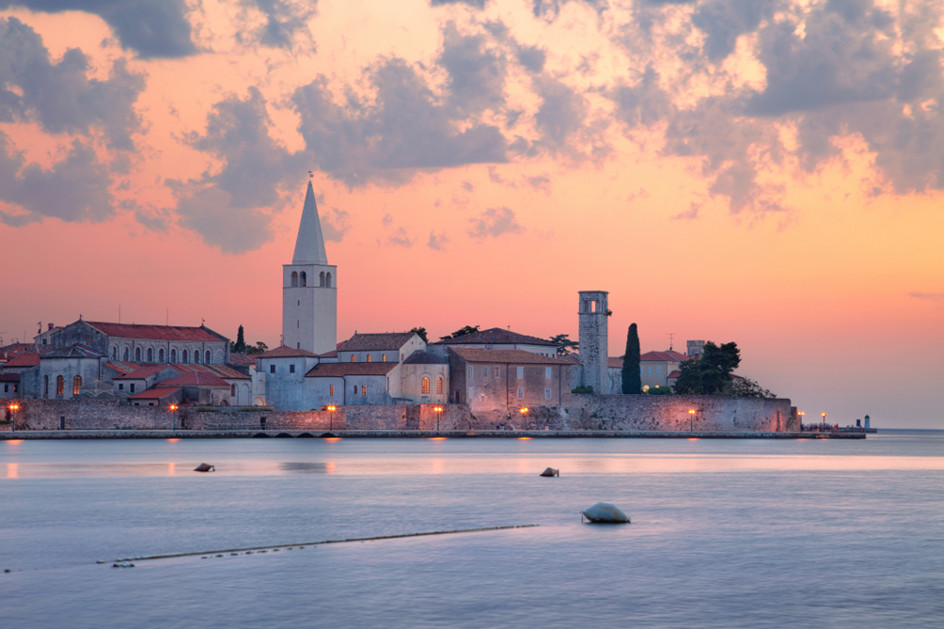
POREČ, CROATIA
A BEAUTIFUL TOWN

Slide 24
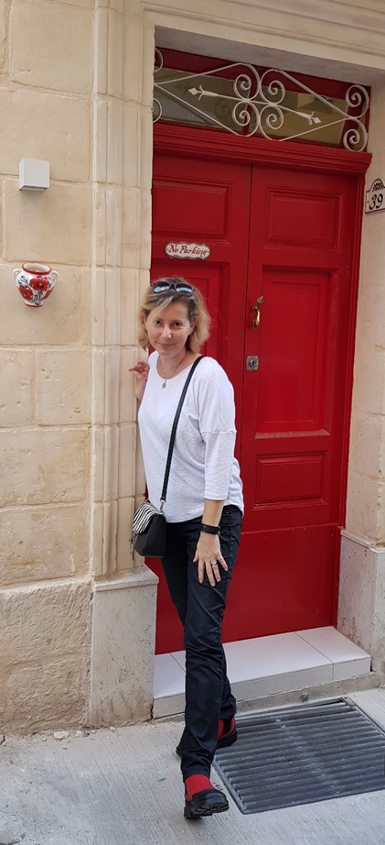
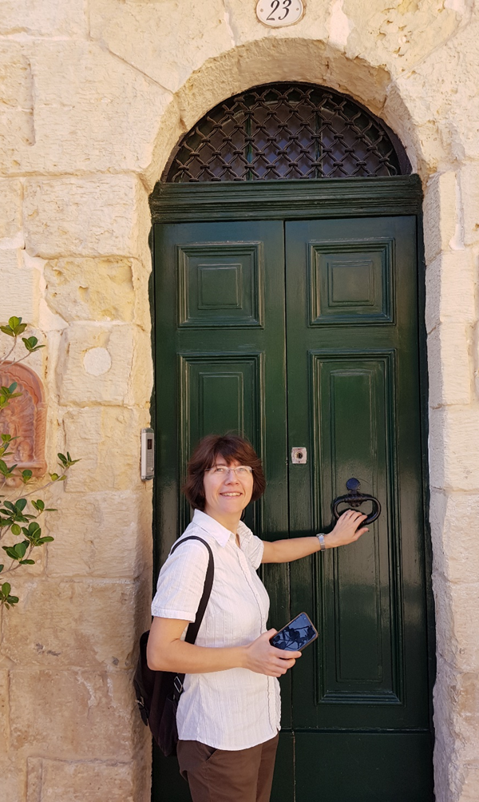
ivanaburick@gmail.com
Ivana Burić Kurtović, MA
eva.bogdanovic1@gmail.com
Eva Bogdanović, MA
THANK YOU
THE END

